Slide 1
UNIT - 4
FUNCTION AND MODULE

Slide 2
FUNCTION : A function is a block of code which only runs when it is called. You can pass data, known as parameters, into a function.
1)A function can return data as a result.
2)Function is always define by the def function.
There are two types of functions in python:
1)User-Defined Functions - these types of functions are defined
by the user to perform any specific task.
2) Built-in Functions - these types of functions are pre-defined in
python.

Slide 3
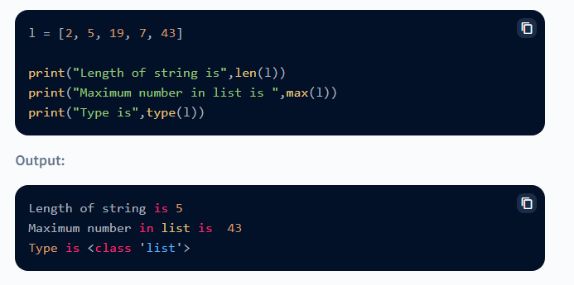
EXAMPLE OF BUILT IN FUNCTION

Slide 4
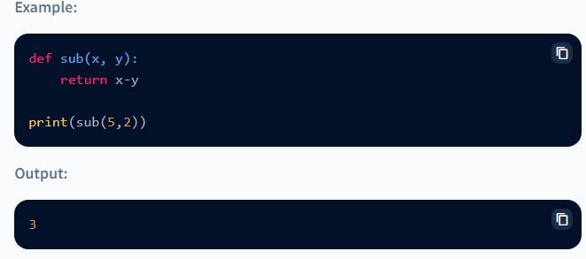
EXAMPLE OF USER DEFINED FUCTION

Slide 5
ARGUMENTS AND RETURN VALUE
In general, a function takes arguments (if any), performs some operations, and returns a value (or object). The value that a function returns to the caller is generally known as the function's return value. All Python functions have a return value, either explicit or implicit.
EXAMPLE :
def my_function(x): return 5 * x print(my_function(3)) print(my_function(5)) print(my_function(9))
OUTPUT
15
25
45

Slide 6
FORMAL AND ACTUAL ARGUMENTS
1)When a function is defined, it may have some parameters. These parameters are useful to
receive values from outside of the function. They are called 'formal arguments’.
2)When we call the function, we should pass data or values to the function. These values are
called 'actual arguments’.
In the following code, 'a' and 'b' are formal arguments and 'x' and 'y' are actual arguments.
EXAMPLE:
def sum(a, b): #a, b are formal arguments
c = a+b
print(c)
x=10
y=15
sum(x, y)
OUTPUT
25

Slide 7
The actual arguments used in a function call are of 4 types:
1)Positional arguments
2)Keyword arguments
3)Default arguments
4)Variable length arguments
1) Positional Arguments
These are the arguments passed to a function in correct positional order. Here, the number of
arguments and their positions in the function definition should match exactly with the number
and position of the argument in the function call.
EXAMPLE:
def attach(s1, s2):
s3 = s1+s2
print('Total string: '+s3)
attach('New', 'York')
OUTPUT
NEWYORK

Slide 8
2) Keyword Argument : This is used to pass the values with name of variable so that we can pass values without bothering the sequence of parameters .
Ex : def fun(x, y):
c=x+y
print (“result is = : “,c)
fun (x=10,y=20)
fun (y=40,x=10)
Fun()
Output :
30
50

Slide 9
3)Default Arguments
We can mention some default value for the function parameters in the definition. Let's take the example of fun() function as:
EXAMPLE:
def fun (x=10,y=30):
c=x+y
print (“Result is = : “ , C)
fun (89,9)
fun ()
OUTPUT
98
40

Slide 10
4)Variable Length Arguments or Range argument:
Sometimes, the programmer does not know how many values a function may receive. In that case, the programmer cannot decide how many arguments to be given in the function definition.
For example, if the programmer is writing a function to add two numbers, he can write: add(a, b) But, the user who is using this function may want to use this function to find sum of three numbers. In that case, there is a chance that the user may provide 3 arguments to this function as:
add(10, 15, 20) Then the add() function will fail and error will be displayed . If the programmer wants to develop a function that can accept 'n' arguments, that is also possible in Python.
In other words we can pass arguments in different number of arguments in different function call. It will handle all the arguments using pointer.
Ex: def fun (*x) def fun(*x)
fun (1,2,3) for i in x :
fun () print (i)
fun (5,7)
fun (1,2,3,4)
fun (“sachin ”,”kumar”)

Slide 11
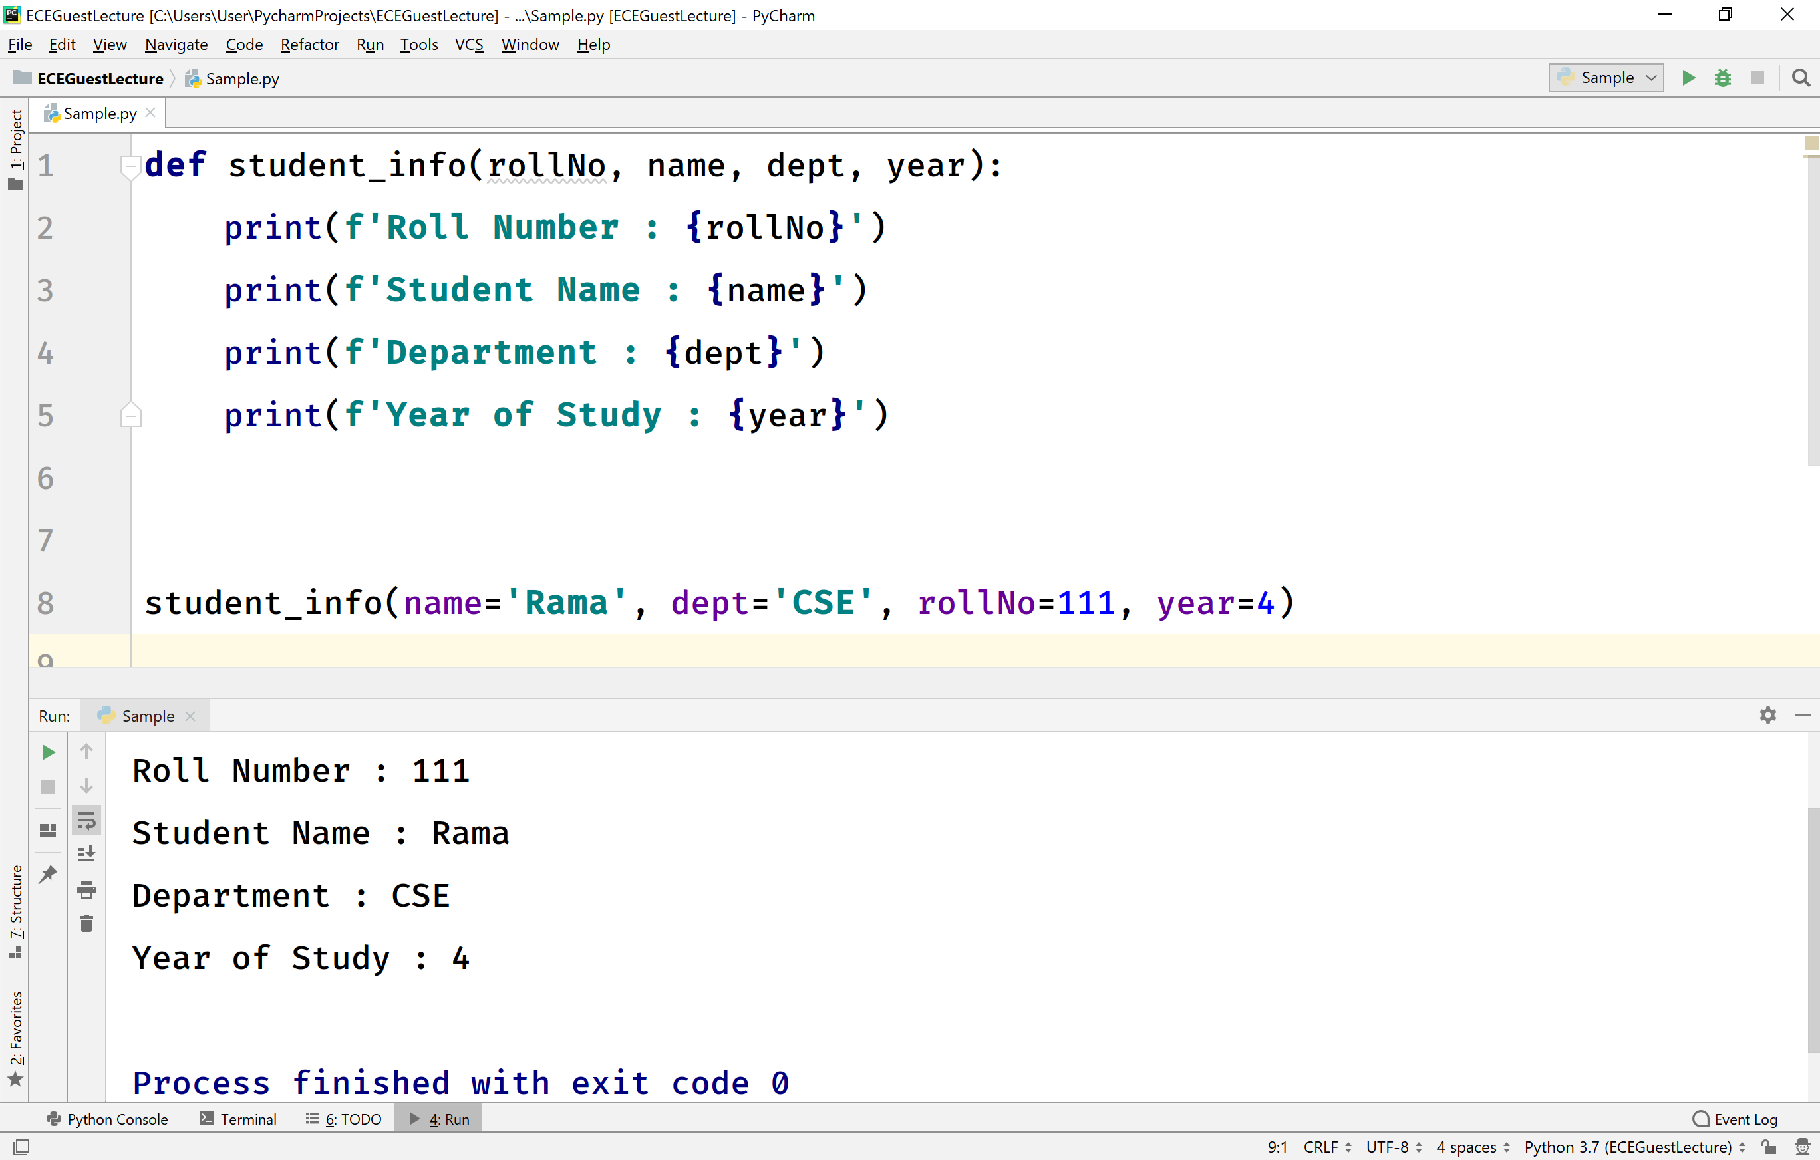
NAMED ARGUMENT
Named arguments or keyword arguments are a way to pass values to parameters by using the parameter name and an equal sign
EXAMPLE

Slide 12
PASS ARGUMENT
In Python programming, the pass statement is a null statement which can be used as a placeholder for future code. Suppose we have a loop or a function that is not implemented yet, but we want to implement it in the future. In such cases, we can use the pass statement.
The syntax of the pass statement is: pass
EXAMPLE
n = 10
# use pass inside if statement
if n > 10:
pass
print('Hello’)
Output
Hello

Slide 13
Default arguments in Python
Python allows function arguments to have default values. If the function is called without the argument, the argument gets its default value.
Default Arguments:
Python has a different way of representing syntax and default values for function arguments. Default values indicate that the function argument will take that value if no argument value is passed during the function call. The default value is assigned by using the assignment(=) operator of the form keyword name = value.
EXAMPLE
def student(firstname, lastname ='Mark', standard ='Fifth'):
print(firstname, lastname, 'studies in', standard, 'Standard')
# 1 positional argument
student('John')
# 3 positional arguments
student('John', 'Gates', 'Seventh')
# 2 positional arguments
student('John', 'Gates')
student('John', 'Seventh')

Slide 14
Output:
John Mark studies in Fifth Standard
John Gates studies in Seventh Standard
John Gates studies in Fifth Standard
John Seventh studies in Fifth Standard
ARBITARY ARGUMENTS
In Python, arbitrary arguments (also known as variable-length arguments) are used when you want to pass a variable number of arguments to a function. There are two types of arbitrary arguments: *args and **kwargs. The *args syntax allows a function to receive any number of positional arguments as a tuple.
Example
#If the number of arguments is unknown, add a * before the parameter name:
def my_function(*kids):
print("The youngest child is " + kids[2])
my_function("Emil", "Tobias", "Linus")
OUTPUT
The youngest child is Linus

Slide 15
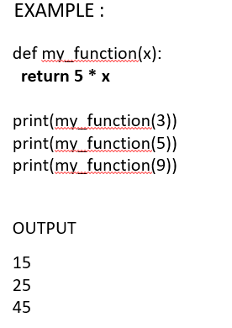
RETURN A VALUE FROM A FUNCTION
A return statement is used to end the execution of the function call and “returns” the result (value of the expression following the return keyword) to the caller. The statements after the return statements are not executed. If the return statement is without any expression, then the special value None is returned. A return statement is overall used to invoke a function so that the passed statements can be executed.

Slide 16
Returning Multiple Values in Python
In Python, we can return multiple values from a function.
# A Python program to return multiple
class Test:
def __init__(self):
self.str = “ARJUN"
self.x = 20
# This function returns an object of Test
def fun():
return Test()
# Driver code to test above method
t = fun()
print(t.str)
print(t.x)
Output
ARJUN
20

Slide 17
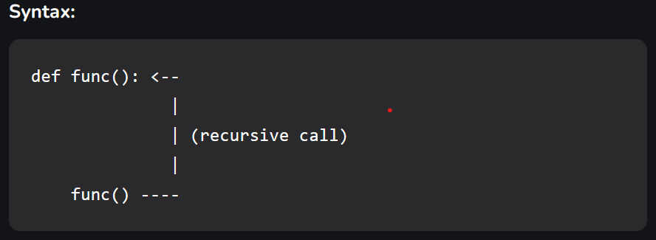
Recursion in Python
The term Recursion can be defined as the process of defining something in terms of itself. In simple words, it is a process in which a function calls itself directly or indirectly.
Example: A Fibonacci sequence is the integer sequence of 0, 1, 1, 2, 3, 5, 8….

Slide 18
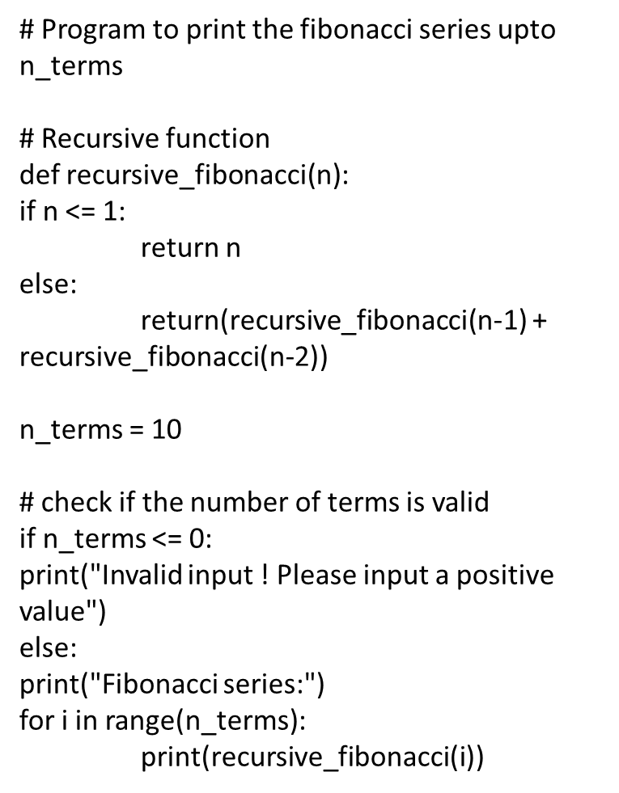

Slide 19
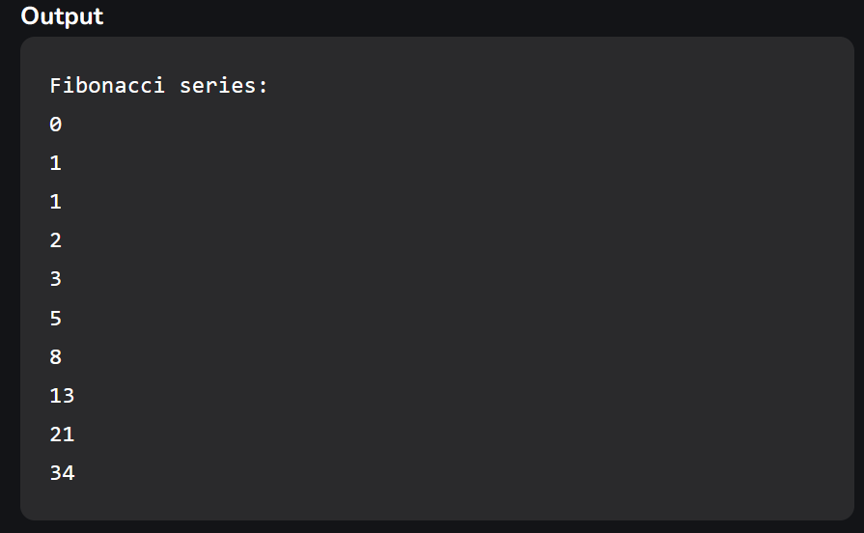

Slide 20
INTRODUCTION TO MODULE IN PYTHON
What is Python Module
A Python module is a file containing Python definitions and statements. A module can define functions, classes, and variables. A module can also include runnable code. Grouping related code into a module makes the code easier to understand and use. It also makes the code logically organized.
Create a simple Python module
# A simple module, calc.py
def add(x, y):
return (x+y)
def subtract(x, y):
return (x-y)
Importing modules in Python
Now, we are importing the calc that we created earlier to perform add operation.

Slide 21
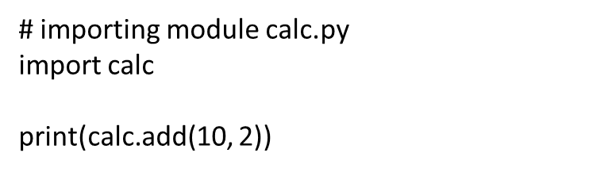
EXAMPLE
OUTPUT
12
Python Math Module
Sometimes when working with some kind of financial or scientific projects it becomes necessary to implement mathematical calculations in the project. Python provides the math module to deal with such calculations. Math module provides functions to deal with both basic operations such as addition(+), subtraction(-), multiplication(*), division(/) and advance operations like trigonometric, logarithmic, exponential functions.

Slide 22
EXAMPLES
# Import math Library
import math
# Print the value of pi
print (math.pi)
OUTPUT
3.141592653589793
EXAMPLE 2 :
# Import math Library
import math
# radius of the circle
r = 4
# value of pie
pie = math.pi
# area of the circle
print(pie * r * r)

Slide 23
Output:
50.26548245743669
RANDOM OS MODULE IN PYTHON
OS module in Python provides functions for interacting with the operating system. OS comes under Python’s standard utility modules. This module provides a portable way of using operating system dependent functionality. os.urandom() method is used to generate a string of size random bytes suitable for cryptographic use or we can say this method generates a string containing random characters.
EXAMPLE
# Python program to explain os.urandom() method
# importing os module
import os
# Declaring size
size = 5
# Using os.urandom() method
result = os.urandom(size)
# Print the random bytes string
# Output will be different everytime
print(result)

Slide 24
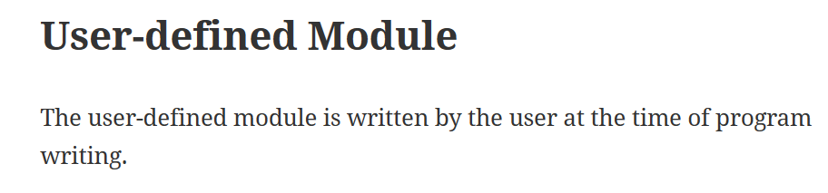
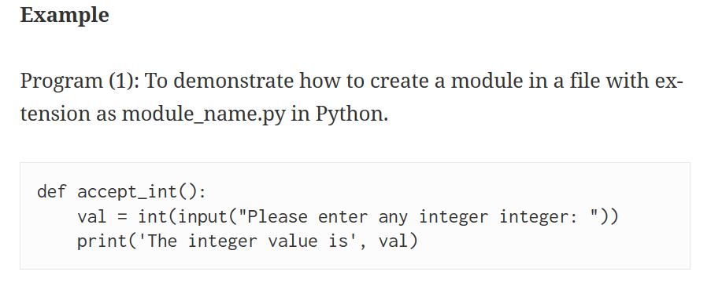
Output:
b'\xe2\xaf\xbc:\xdd'
TO CREATE USER DEFINED MODULE IN PYTHON

Slide 25
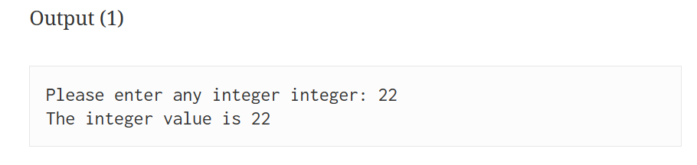

Slide 26
THANK YOU

